Slide 1



CRM Analysis
CRM
Group No 4
01
Mr. Tushar Khapre
Mr. Vishal Harinath Yadav
Mr. Siddhesh Subhash Auti
Mr. Shubham Dnyandev Chavan
Mr. KIRAN V
Miss. Namburi Ramya Devi
Mr. Saklen innus Attar
06
02
05
04
03

Slide 2
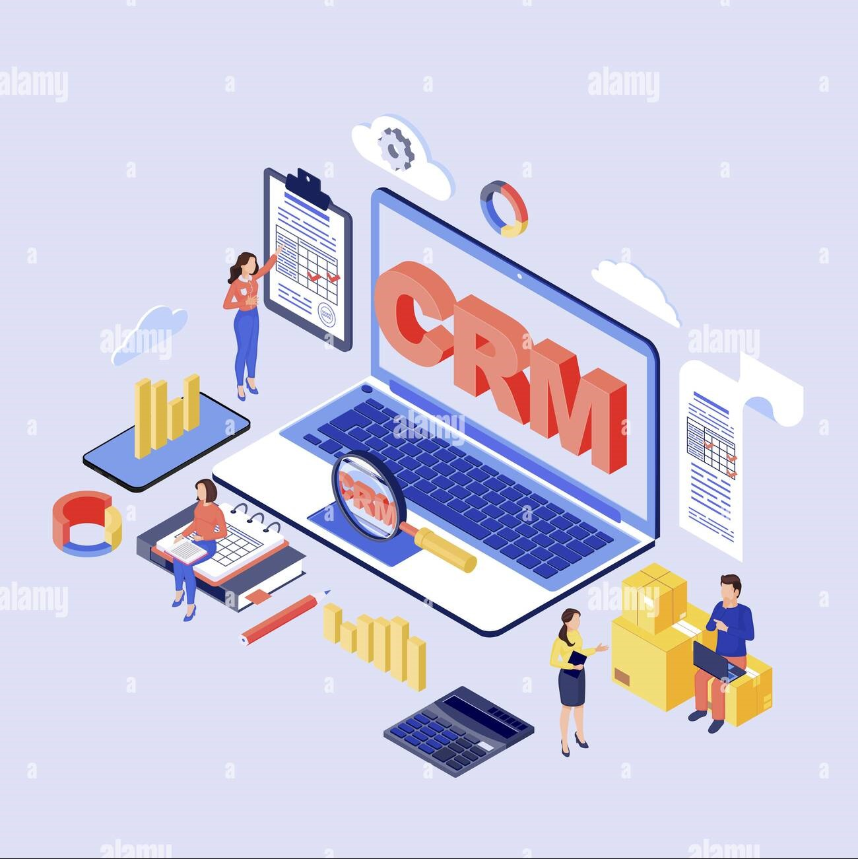
CRM
Introduction to CRM Analytics
Customer Relationship Management (CRM) analytics is the process of extracting insights from customer data to improve business strategies and decision-making. It involves gathering, analyzing, and interpreting data from various sources to gain a deeper understanding of customer behavior, preferences, and pain points. By leveraging CRM analytics, organizations can optimize their sales, marketing, and customer service efforts, leading to increased customer satisfaction, loyalty, and ultimately, business growth.

Slide 3

Summary
CRM
Yearly Performance Overview:
Yearly Revenue: Highlights our growth trajectory and the impact of sales strategies on business performance.
Yearly Lead Generation: Tracks lead acquisition effectiveness over the years.
Lead Generation Overview:
Total Leads: Snapshot of leads generated within the specified period.
Lead Sources: Breakdown of lead sources like digital campaigns, referrals, and social media.
Lead Conversion Rate:
Conversion Rate: Key indicator of lead-to-customer conversion success.
Conversion Trends: Analysis of factors influencing conversion rates over time.
Opportunities Analysis:
Current Opportunities: Overview of potential sales in the pipeline.
Opportunity Value: Assesses potential revenue to prioritize high-value opportunities.

Slide 4


CRM
Analyzing Leads and Opportunities
Lead Analysis
Opportunity Analysis
CRM analytics enables organizations to understand the quality and quantity of leads generated through various channels, such as website visits, marketing campaigns, and referrals. By analyzing lead data, businesses can identify patterns, trends, and bottlenecks in the lead generation process, allowing them to optimize their marketing strategies and allocate resources more effectively.
CRM analytics also focuses on the analysis of sales opportunities, including win rates, conversion rates, and the value of potential deals. By understanding the factors that influence the success or failure of sales opportunities, companies can develop more effective sales strategies, tailor their approach to different customer segments, and ultimately, improve their overall sales performance.

Slide 5

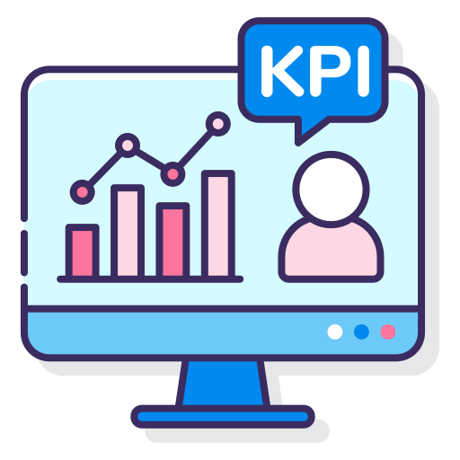
CRM
KPI’s
Leads KPI’s
Opportunity KPI’s
Total Leads: 10,000
"This year, we generated 10,000 leads."
Converted Accounts: 1,005
"1,005 leads were converted into accounts.“
Converted Opportunities: 411
"We secured 411 opportunities from these accounts.“
Lead Conversion Rate: 10.53%
The lead conversion rate is 10.53%.
Converted Lead Amount: $220,013.72
Converted leads contributed $220,013.72 in revenue.
Expected Amount: $10,731,261
The expected revenue is $10,731,261 From Opp.
Active Opportunities: 1,110
We have 1,110 active opportunities in progress.
Conversion Rate: 33.99%
Our conversion rate is 33.99%.
Win Rate: 33.89%
Our win rate is 33.89%.
Loss Rate: 66.94%
The loss rate is 66.94%.

Slide 6

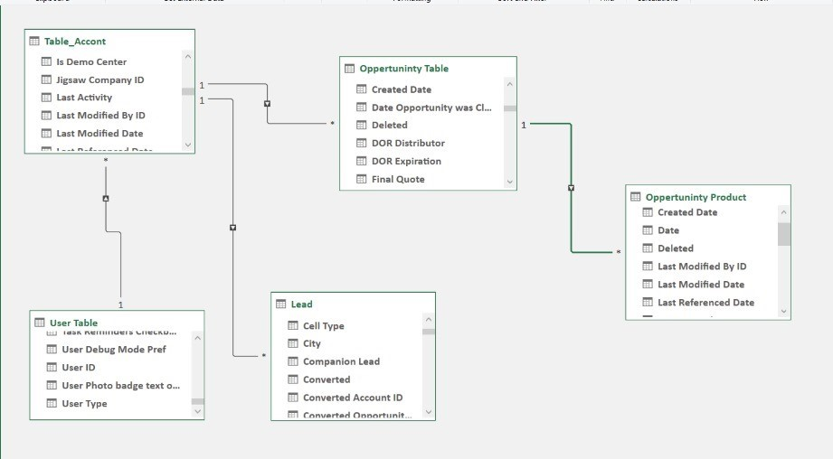

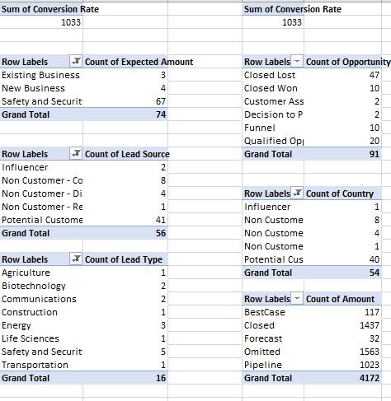
CRM
Data Modeling with Excel
Data Model
Organize Data Efficiently: The data model ensures that all information related to accounts, opportunities, leads, users, and products is organized systematically.
Establish Relationships: It defines how different pieces of data relate to each other, enabling complex queries and reports (e.g., linking a lead to the user managing it and the account it converts into).
Support Business Processes: The model supports key business processes like lead management, opportunity tracking, and sales reporting, making it easier to manage customer relationships and sales activities.
Pivot Table
Quick Data Summarization: The pivot tables above quickly summarize large volumes of CRM data, making it easier to spot trends and patterns.
Easy Comparisons: By breaking down data by business type, lead source, opportunity status, and more, the pivot tables facilitate easy comparisons.
Data Exploration: Pivot tables allow for interactive exploration of data, letting users adjust the view to explore different aspects of the dataset without needing to alter the raw data.

Slide 7
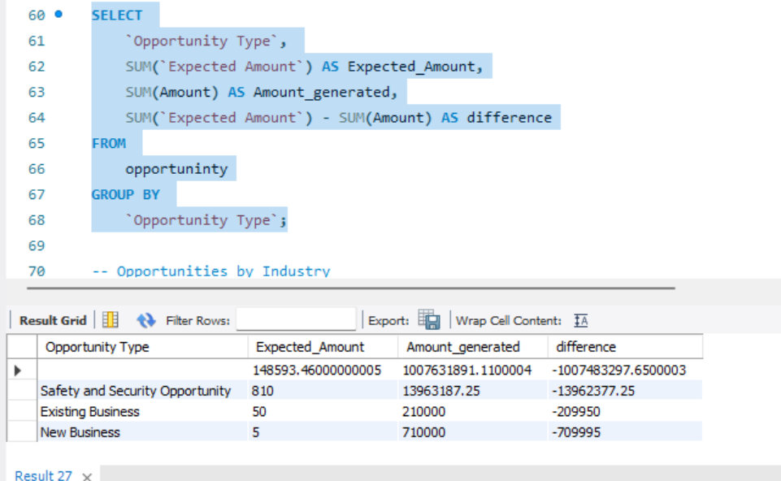

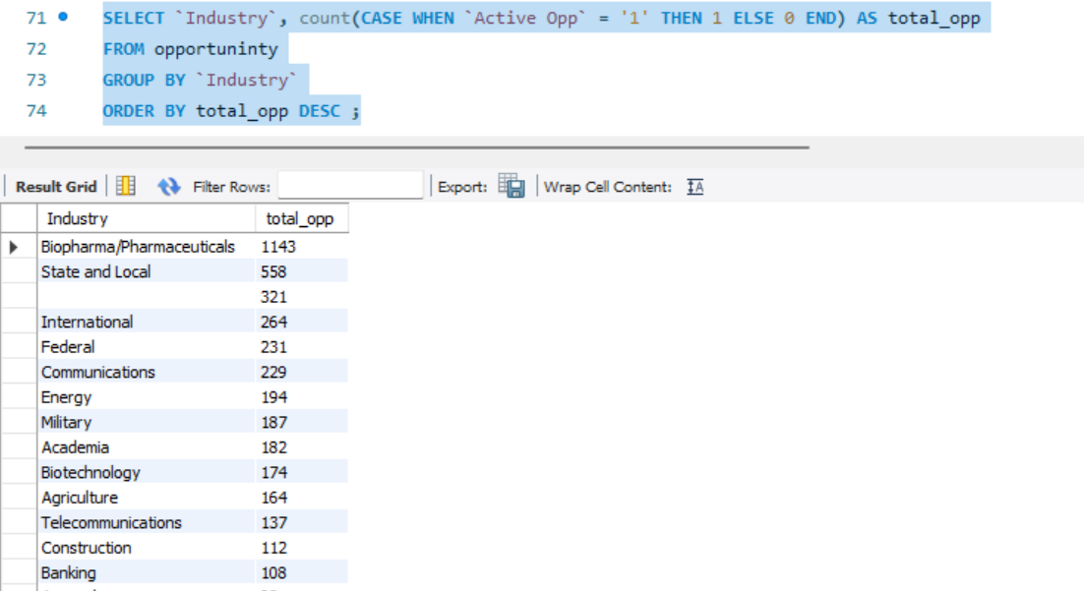
CRM
Validating Data with SQL
Data Validation & Data Integrity
Accuracy and Consistency: We implement validation rules and constraints to maintain precise and consistent data. Regular audits and checks help prevent incorrect entries.
Secure SQL Joins: We design SQL joins to enhance performance and security, preventing unauthorized access and mitigating risks like SQL injection. Techniques such as parameterized queries and view-based controls are used.
Data Transformation & Data Cleansing
In addition to validation, SQL can be used to transform CRM data into a format that is more suitable for analysis. This could involve merging data from multiple sources, creating calculated fields, or aggregating data to provide higher-level insights.

Slide 8

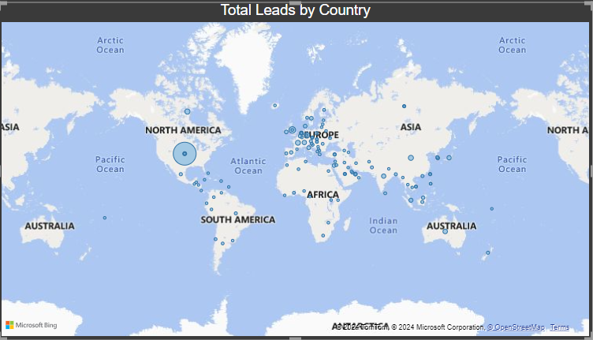
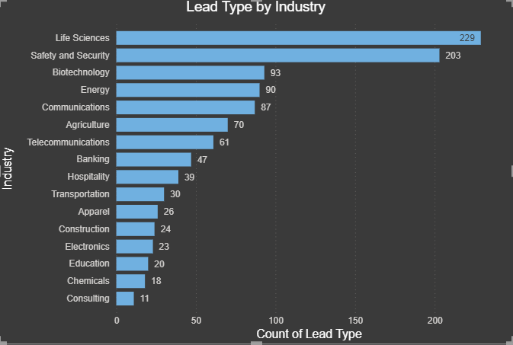
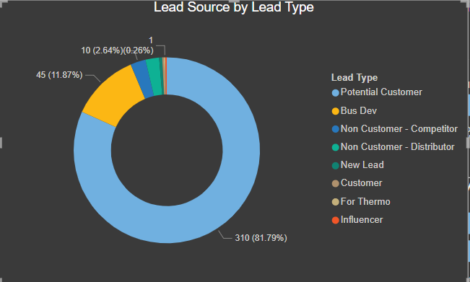
CRM
Visualization with Power BI
Lead Source by Lead Type:
Top Insight: The majority of leads (81.79%) come from "New Leads," indicating a strong inflow of fresh opportunities.
Bottom Insight: The smallest portion of leads (0.26%) comes from "Potential Customers," highlighting a potential area for growth.
Total Leads by Country:
Top Insight: The majority of leads are concentrated in North America, indicating a strong focus on this region.
Bottom Insight: There are minimal or no leads in large parts of Africa, Asia, and South America, suggesting under-penetrated markets.
Lead Type by Industry:
Top Insight: "Life Sciences" leads the industries with 229 leads, followed closely by "Safety and Security" with 203 leads, showing these are the most active sectors.
Bottom Insight: The "Banking" and "Hospitality" industries have the fewest leads, with only 47 and 30 respectively, indicating lower engagement in these sectors.

Slide 9

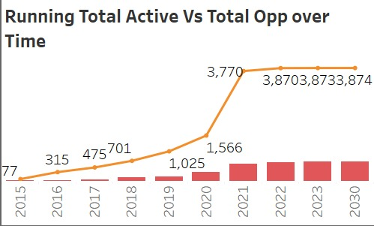
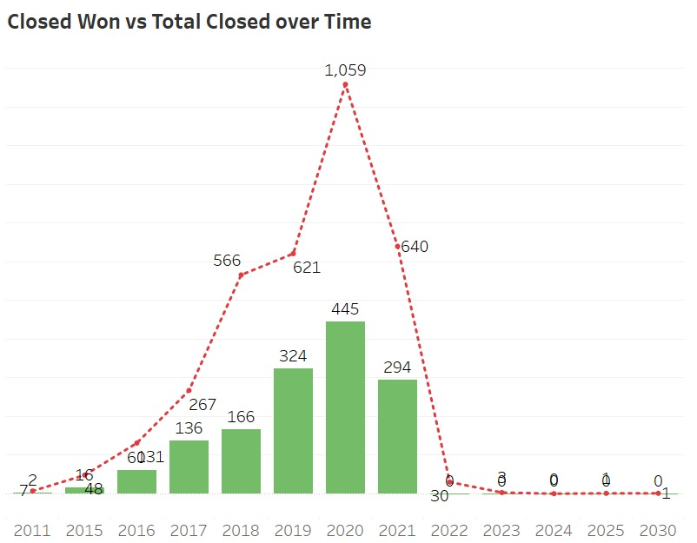
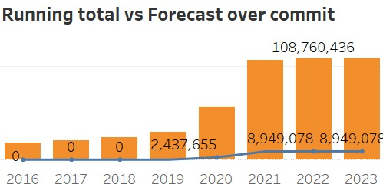
CRM
Visualization with Tableau
Running Total vs. Forecast over Commit:
Top Insight: The forecasted opportunities overcommit saw a sharp increase, peaking at 108,760,436 in 2021, indicating a strong expectation of opportunity closure.
Bottom Insight: There were no forecasted opportunities until 2019, and the forecast remained relatively stable from 2021 to 2023.
Running Total Active vs. Total Opportunities over Time:
Top Insight: The running total of active opportunities significantly increased from 2018 to 2020, peaking at 3,874 opportunities in 2020.
Bottom Insight: The growth of total opportunities slowed down significantly after 2020, with little to no increase seen in the following years.
Closed Won vs Total Closed Over Time:
Growth Period:2016-2020:Steady increase in both closed won and total closed deals.
Decline Phase:2021 onwards: Sharp decrease in closed deals, nearly negligible by 2022 and beyond.
Key Insights: 2020 marked the peak in deal closures, followed by a significant drop, indicating possible market challenges or external factors impacting performance.

Slide 10
Key Takeaways from Data Insights
1. Growth Plateau: Opportunities and forecasts grew initially but plateaued post-2020, indicating potential market saturation or shifts.
2. Key Industries: Biopharmaceutical and Safety/Security sectors are leading in opportunities and leads, suggesting a focus on these industries could be beneficial.
3. Regional Insights: North America leads in leads, while Africa, Asia, and South America are underperforming, indicating untapped markets.
4. Lead Utilization: New leads are abundant, but potential customers are underutilized, highlighting a need for better conversion strategies.
5. High-Value Focus: Concentration on high-value applications like Chemical Warfare Agents is clear, but diversification could reduce risk.
6. Post-2020 Decline: A drop in closed-won opportunities after 2020 may require strategic adjustments to address market or internal challenges.
Strategic Considerations
Expand Markets: Increase efforts in under-represented regions like Africa, Asia, and South America.
Improve Conversion: Develop strategies to better convert potential customers.
Revise Strategies: Investigate the decline in opportunities and adjust market strategies accordingly.
Diversify Focus: Broaden application focus beyond CWAs to mitigate risk and capture more market share.

Slide 11

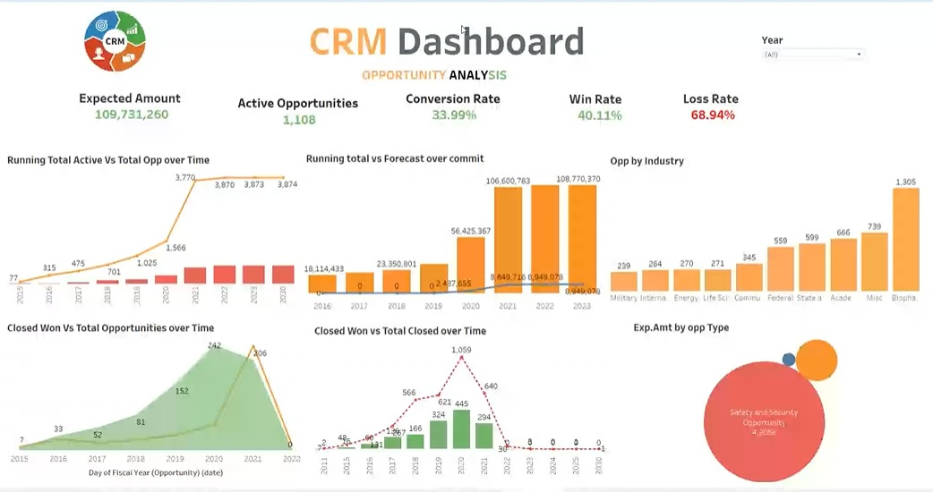
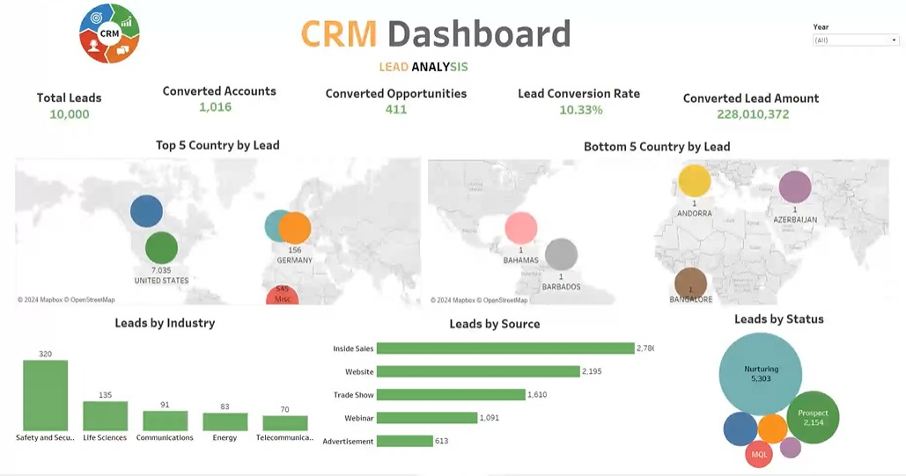
Conclusion
In conclusion, CRM analytics is a powerful tool that can help organizations unlock the full potential of their customer data, leading to improved decision-making, enhanced customer experiences, and ultimately, increased business success. By leveraging the insights gained from CRM analytics, organizations can optimize their sales processes, identify and capitalize on new opportunities, and stay ahead of the competition in an ever-evolving business landscape.
As organizations continue to recognize the strategic importance of CRM analytics, the next steps may involve exploring emerging technologies, such as artificial intelligence and machine learning, to further enhance the predictive capabilities of CRM systems, as well as investing in the development of in-house analytics expertise to continuous improvement and innovation.

